Slide 2

Domain Specific Languages for Parallel Graph AnalytiX (PGX)
Guido Wachsmuth
Principal Member of Technical Staff
Oracle Labs Zurich, Switzerland
January 8, 2019

Slide 3
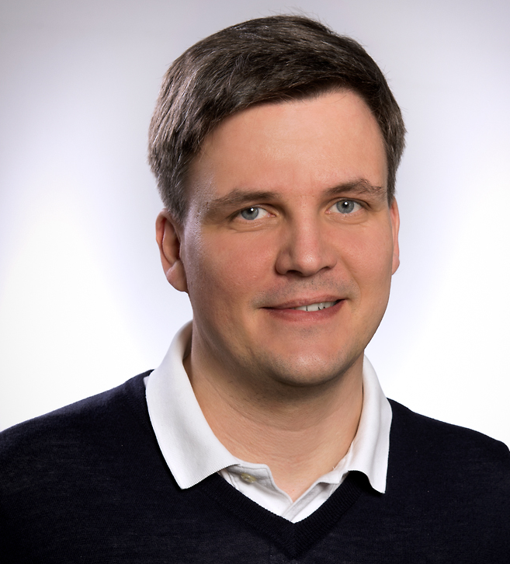
Meet Oracle Labs
Guido Wachsmuth
Principal Member of Technical Staff
Oracle Labs Zurich, Switzerland

Slide 4
Meet Oracle Labs
Martijn Dwars
Member of Technical Staff
Oracle Labs Zurich, Switzerland

Slide 6

Oracle Corporation
Scale
Innovation
US$40 billion total GAAP revenue in FY 2018
43k customers in 175 countries
25k partners
More than 137k employees
14k support and services specialists
19k implementation consultants
More than US$48 billion in R&D over the last 10 years
38k developers and engineers
6.3M students supported annually in 128 countries
More than 18K patents
5M registered members of the Oracle Developer Community
484 independent user communities in 92 countries
Notes:
Some quick facts about Oracle…

Slide 7
Oracle Leadership
#1
Technologies
Applications
Application Server
Database
Database on Linux and Unix
Data warehouse
Deployment-centric applications platform
Embedded database
Engineered systems
Middleware
Business analytics
Database management
Enterprise performance management
Lead management
Marketing automation
Structural data management
Supply chain execution
Talent management
Notes:
Oracle is recognized as the number one provider in key IT segments, a testament to our best-of-breed strategy, which is to deliver the best possible options to our customers across the stack, while remaining open so that customers can utilize Oracle in hybrid environment.

Slide 8






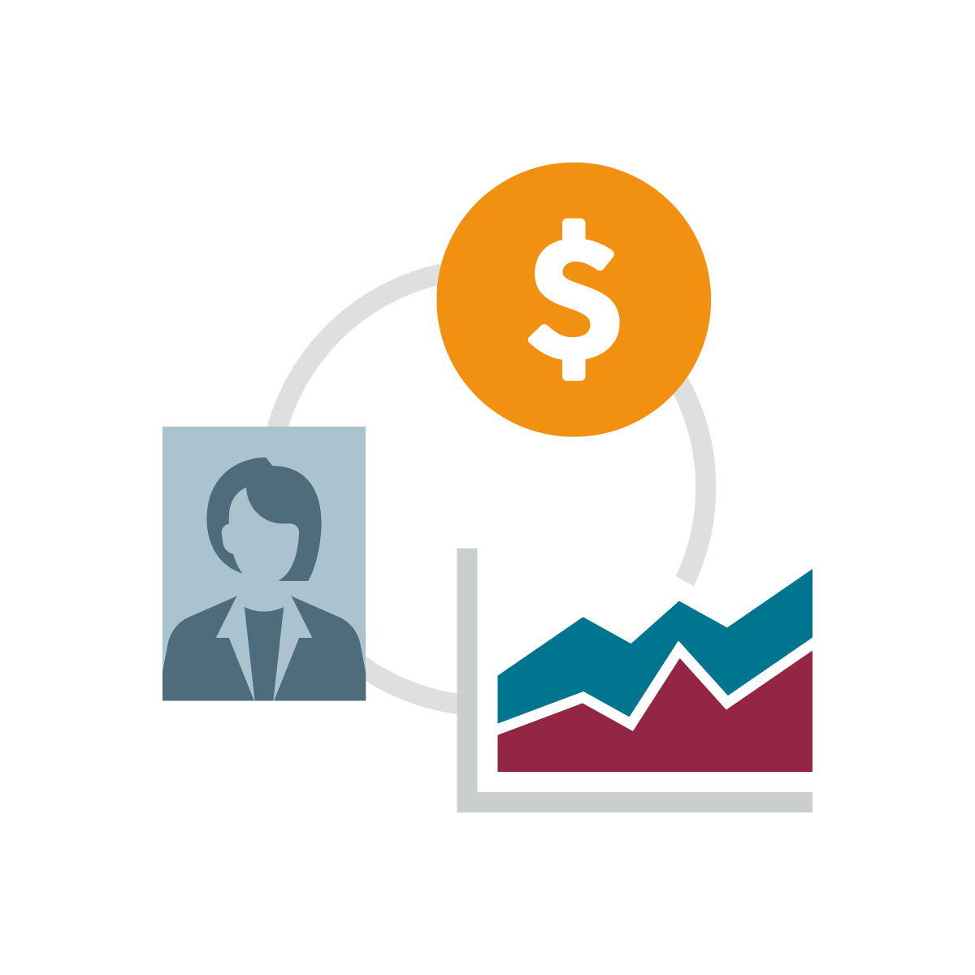








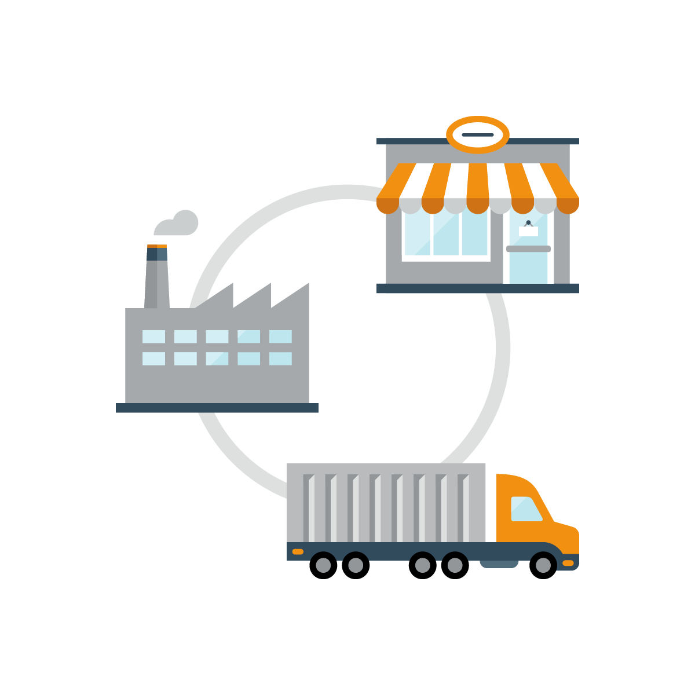



Oracle Customers
AEROSPACE AND DEFENSE
10 out of 10 top companies
AUTOMOTIVE
20 out of 20 top companies
CLOUD
10 out of 10 top SaaS providers
CONSUMER GOODS
9 out of 10 top companies
EDUCATION AND RESEARCH
20 out of 20 top universities
#1
#1
#1
ENG. AND CONSTRUCTION
9 out of 10 top companies
FINANCIAL SERVICES
20 out of 20 top banks
HIGH TECHNOLOGY
20 out of 20 top companies
INSURANCE
20 out of 20 top insurers
MANUFACTURING
20 out of 20 top companies
#1
#1
#1
#1
MEDICAL DEVICES
20 out of 20 top companies
OIL AND GAS
20 out of 20 top companies
PHARMACEUTICALS
20 out of 20 top companies
PUBLIC SECTOR
20 out of 20 top governments
RETAIL
20 out of 20 top companies
#1
#1
#1
SUPPLY CHAINS
20 out of 20 top companies
TELECOMMUNICATION
20 out of 20 top companies
TRAVEL AND TRANSPORT
20 out of 20 top airlines
UTILITIES
10 out of 10 top companies
Notes:
This scorecard is a testament to Oracle’s solid presence across a broad range of industries, as well as customer successes we have helped build.

Slide 9
Investment in Research and Development
MORE THAN $57 BILLIONS SINCE 2004
Notes:
Since 2004, Oracle has invested more than US$51 billion in continued innovation of our products, so we can ensure that each of our product is best-of-breed in the industry and in integration, so we can deliver products that work together.

Slide 10
“The Mission of Oracle Labs is straightforward: Identify, explore, and transfer new technologies that have the potential to substantially improve Oracle's business.”
Oracle Labs mission statement

Slide 11
Parallel Graph AnalytiX

Slide 12
Data as a Graph
Vertex: entity
Edge: relationship
Labels: identify vertices and edges
Properties: describe vertices and edges
:Attended
date=20190108
:Person
Name = “Guido”
:Lecture
Title = “DSLs for PGX”

Slide 13

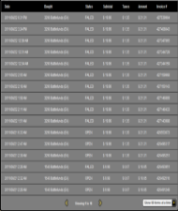










Example Applications
Product recommendation
Influencer identification
Recommend the most similar item purchased by similar people
Find out people that are central in the given network – e.g. influencer marketing
Purchase Record
Communication Stream (e.g. tweets)
Community detection
Graph pattern matching
Identify group of people that are close to each other – e.g. target group marketing
Find out all sets of entities that match a given pattern – e.g. fraud detection
Notes:
Starting from transactional data, we could construct a bipartite graph, run collaborative filtering and generate product recommendations for customers.
We can also use social data to link these customers and find out influencers within that network and use that information to target those influencers with special deals.
We can also use community detection algorithms to segment our customer base and fine tune how and where we reach them.
Finally we can also search for patterns in the data by constructing graph queries.

Slide 14
Built-in Algorithms
PGX provides a rich set of built-in (parallel) graph algorithms
Detecting Components and Communities
Ranking and Walking
Pagerank, Personalized Pagerank,
Betwenness Centrality (w/ variants),
Closeness Centrality, Degree Centrality,
Eigenvector Centrality, HITS,
Random walking and sampling (w/ variants)
Tarjan’s, Kosaraju’s,
Weakly Connected Components, Label Propagation (w/ variants), Soman and Narang’s
Spacification
Evaluating Community Structures
Path-Finding
Conductance, Modularity
Clustering Coefficient (Triangle Counting)
Adamic-Adar
Hop-Distance (BFS)
Dijkstra’s,
Bi-directional Dijkstra’s
Bellman-Ford’s
∑
∑
SALSA
(Twitter’s Who-to-follow)
Vertex Cover
Minimum Spanning-Tree
(Prim’s)
Link Prediction
Other Classics

Slide 15
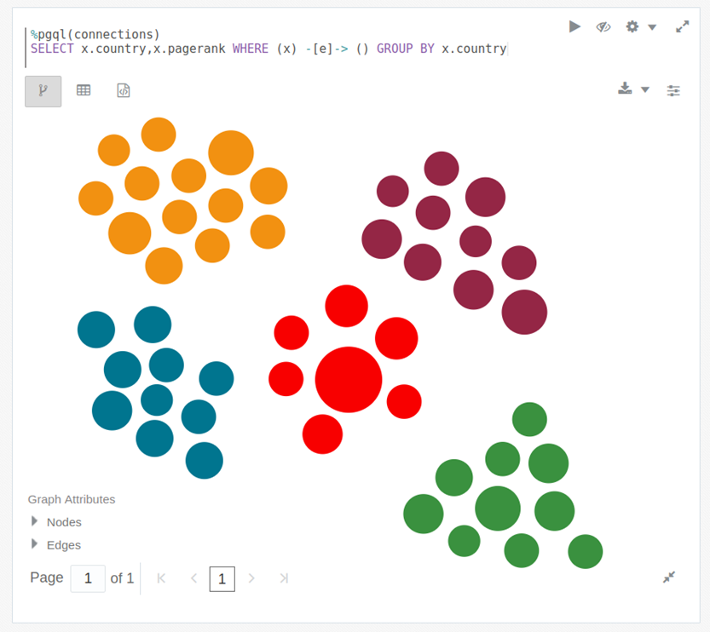

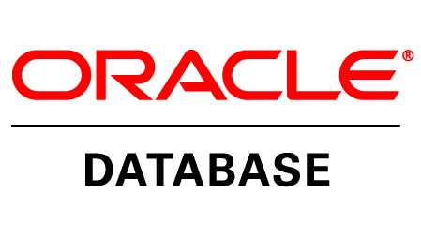
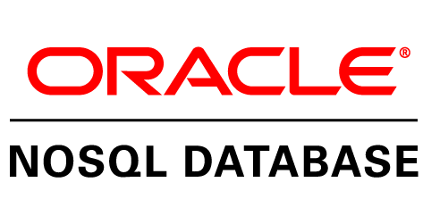



Architecture Overview
Integrated with various Oracle and open source data storage technologies
Interoperates with open-source frameworks, e.g. Apache Spark
In-memory engines for single-machine or distributed execution
Multiple language bindings for remote execution via REST
Notebooks and visualization
(Remote) Clients (Java, Groovy,
R, JS, …)
Visualization
PGX
Rest API
Shared Memory
Distributed
File System
…
Notes:
End-to-end solution to users via multiple layers of integrations

Slide 16
Graph Workloads
Computational graph analytics
Graph pattern matching
Compute values on vertices and edges
While traversing or iterating on the graph
In procedural ways
Connected Components, Shortest Path, Spanning Tree, Pagerank, Centrality
Given a description of a pattern
Find every subgraph which matches the pattern
ex
friend
friend
friend
Domain-specific language: Green-Marl
Domain-specific language: PGQL
Notes:
As we have examined the different types of graph workloads people were talking about, we saw 2 large classes of workloads emerge
PGX supports both kinds of workloads, as well as combinations of both

Slide 17
PGX: Domain-Specific Languages
Client
user implements algorithm/query using DSL and submits it to PGX
DSL Program
PGX

Slide 18
PGX: Domain-Specific Languages
Client
DSL Program
PGX
DSL Compiler
DSL compiler aggressively optimizes code and generates compiled program
Compiled Program

Slide 19
PGX: Domain-Specific Languages
Client
DSL Program
PGX
DSL Compiler
Internal Data-Structures
compiled program has direct access to internal data-structures
Compiled Program

Slide 20
Compiled DSL Benefits
Client
portability: write once, compile for different backends
shared-memory
distributed
DSL Program
PGX
DSL Compiler
Internal Data-Structures
Compiled Program

Slide 21
Compiled DSL Benefits
Client
Client
portability: write once, compile for different backends
shared-memory
distributed
performance benefits
graph specific optimizations
no performance overhead from API
Java Program
DSL Program
PGX
API
DSL Compiler
Internal Data-Structures
Compiled Program

Slide 22
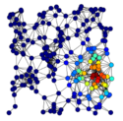
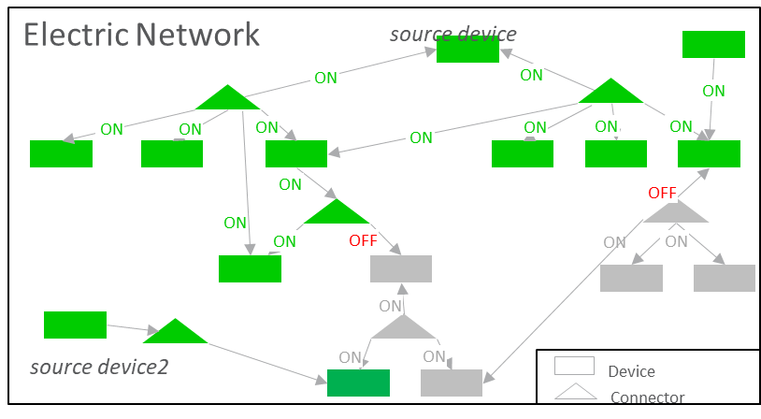
Centrality Algorithms and there Application
What is this about:
“Find me the most important entity in this graph data set”
(but on what account?)
From graph theory:
Centrality – a measure of relative importance of vertices in a graph n a graph
There are many different centralities defined
: Pagerank, Betweenness Centrality, HITS, Closeness Centrality, Eigenvector, ….
Betweeness Centrality
Vertices are considered important, if it is located “in between” other vertices
Example Application: Asset criticality in Power Grid Network
Power lines, transformer, relay, …
Failure of which node makes
larger damage?
In case of storm, which node
should be fixed first?
(images from Wikipedia)

Slide 23
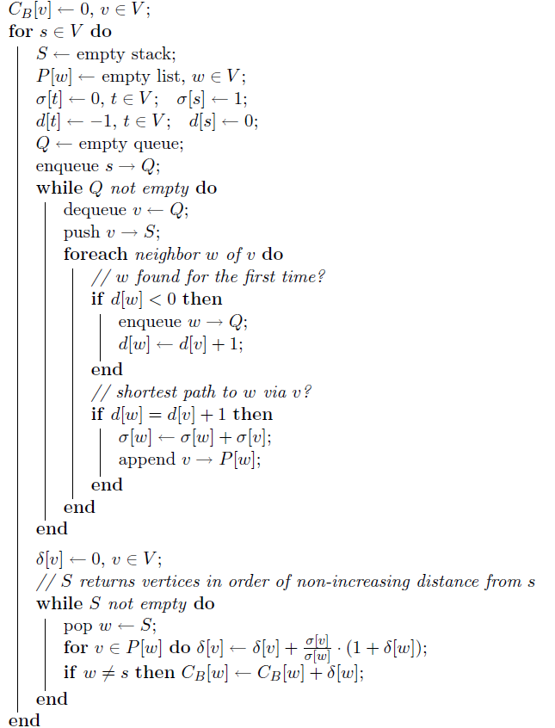
Betweenness Centrality [Brandes 2001]

Slide 24
procedure BC (G: graph; BC: nodeProperty<double>) {
G.BC = 0.0; // initialize
foreach(s: G.nodes) {
// temporary values for each node
nodeProperty<double> sigma;
nodeProperty<double> delta;
G.sigma = 0.0;
s.sigma = 1.0;
// BFS iteration from s
inBFS(v: G.nodes from s) {
// summing over BFS parents
v.sigma = sum(w: v.upNbrs) { w.sigma };
}
inReverse(v != s) { //reverse-BFS iteration to s
// summing over BFS children
v.delta = sum(w: v.downNbrs) {
v.sigma / w.sigma * (1 + w.delta)
};
v.BC += v.delta; // accumulate BC
}
}
}
s
Parallel
BFS
Order
w
w
v
Parallel
Compute sigma from parents
s
Parallel
Reverse
BFS
Order
v
w
w
w
Compute delta from children

Slide 25
Language Workbenches
Opportunities and Challenges

Slide 26
Challenges
usage modes
editor
command line
API for language processing
language composition
open-source frontend
proprietary backends
language build
build system integration
build times
3rd party runtime libraries
vulnerabilities
legal
memory footprint

Slide 27
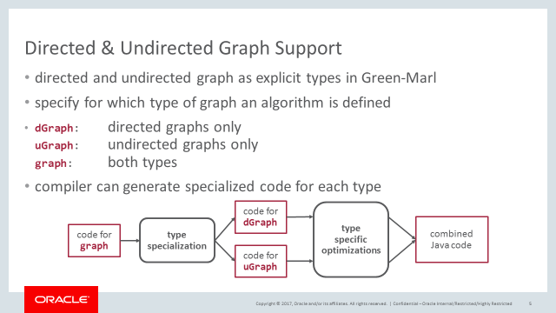
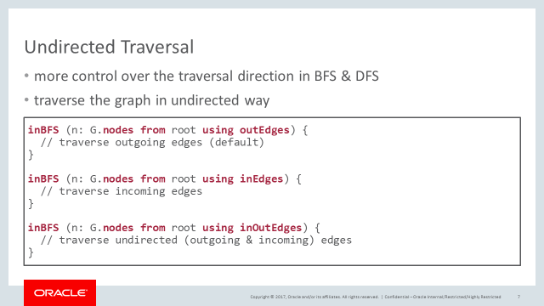
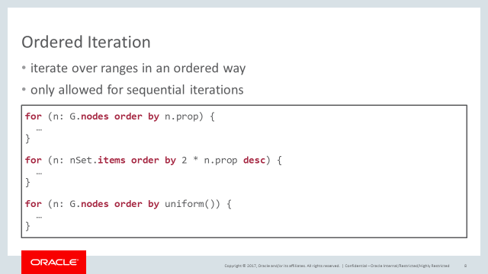
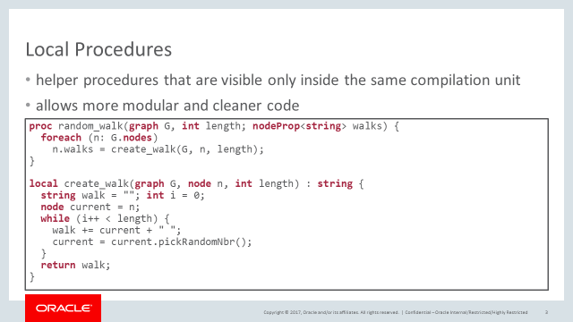
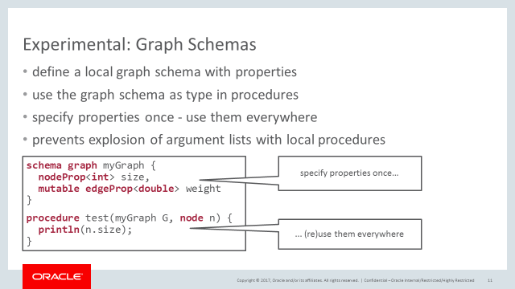
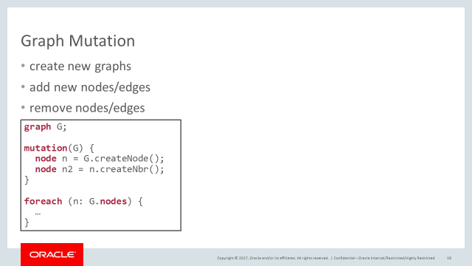
Opportunities: Innovation & Competiveness
CY 2017 language extensions for more use cases
Additional data types and collections
Additional syntactic sugar
Additional optimisations

Slide 28
Example: MS-BFS Optimization
Multi-Source BFS*:
bundle multiple independent BFS traversals and run them at the same time
benefit from common parts in traversal and SIMD instructions
uses cache friendly data access scheme
up to 90x speedup compared to traditional BFS implementation
but hard to implement by hand
has to maintain copies for variables for each traversal in one bundle
has to manage control flow for different traversals
has to differentiate between private and shared variables
DSL compiler can do this automatically
* Then, Kaufmann, Chirigati, Hoang-Vu, Pham, Kemper, Neumann, Vo: The more the Merrier: Efficient Multi-Source Graph Traversal VLDB 2014
Notes:
Depending on the hardware we bundle 64 or 128 iterations in one batch

Slide 29
Example: MS-BFS Optimization
foreach(s: G.nodes) {
long foundNodes = 0; long levelSum = 0;
inBFS(v: G.nodes from s) { foundNodes++; levelSum += currentBFSLevel(); }
}
1. user writes regular Green-Marl code
Notes:
This code snipped is actually part of our Closeness Centrality algorithm. I just cut out everything that is unrelated to the MS-BFS part.

Slide 30
Example: MS-BFS Optimization
foreach(s: G.nodes) {
long foundNodes = 0; long levelSum = 0;
inBFS(v: G.nodes from s) { foundNodes++; levelSum += currentBFSLevel(); }
}
2. compiler identifies MS-BFS pattern…
Notes:
The pattern is actually just that simple: a foreach iterating over the entire graph containing a BFS using the loop iterator as start node

Slide 31
Example: MS-BFS Optimization
batchForeach(s: G.nodes) {
long foundNodes = 0; long levelSum = 0;
inBatchBFS(v: G.nodes from s | index) { foundNodes++; levelSum += currentBFSLevel(); }
}
3. …and transforms the code to do MS-BFS
Notes:
This is not vanilla GM code any more but a representation that our compiler uses internally

Slide 32
Example: MS-BFS Optimization
batchForeach(s: G.nodes) {
long foundNodes = 0; long levelSum = 0;
inBatchBFS(v: G.nodes from s | index) { foundNodes++; levelSum += currentBFSLevel(); }
}
4. then identifies batch-local variables…
Notes:
For each variable used inside a batch (i.e. in a BFS iteration) we need to make sure that the variable is private for it’s iteration and not shared with other. To do so we create a copy of the variable for each iteration (e.g. if we have 64 iterations per batch then we have 64 copies)

Slide 33
Example: MS-BFS Optimization
batchForeach(s: G.nodes) {
long[] foundNodes = new long[batchSize]; long[] levelSum = new long[batchSize];
for(int i = 0; i < batchSize; i++) { foundNodes[i] = 0; levelSum[i] = 0; }
inBatchBFS(v: G.nodes from s | index) { foundNodes[index]++; levelSum[index] += currentBFSLevel(); }
}
5. …and creates one instance per iteration in the batch

Slide 34
Example: MS-BFS Optimization
MS-BFS greatly improves the performance
but creating copies of each variable can have huge impact on memory consumption (e.g. node/edge properties)
system might run out of memory for larger graph instances
using static analysis the compiler determines memory consumption per thread per BFS iteration
compiler generates code that reduces batch-size so that all data fits into memory
Notes:
Depending on the hardware we bundle 64 or 128 iterations in one batch

Slide 35
Example: MS-BFS Optimization
Conclusion:
MS-BFS greatly improves the performance
auto-transformation fully transparent to the user
transparent memory handling
➔ Green-Marl code focuses only on the actual problem, everything else is handled by the compiler
Notes:
Depending on the hardware we bundle 64 or 128 iterations in one batch

Slide 36
Extensible Compiler Architecture
Optimizations
Code generation
Can be combined with one or more backends
Backends
Java
PGX.SM
Normalizations
Name and type analysis
Shared Optimizations
Frontends
Green-Marl
DSL
parser
C++
PGX.DIST
AST
Static Analysis
AST

Slide 37
Extensible Compiler Architecture
Optimizations
Code generation
Can be combined with one or more backends
Backends
Java
PGX.SM
Normalizations
Name and type analysis
Shared Optimizations
Frontends
Green-Marl
DSL
parser
C++
PGX.DIST
AST
Static Analysis
AST
PGX Algorithm
javac +
PGX plugin
PL/SQL
Oracle DB
C
IMC

Slide 38
@GraphAlgorithm public class BetweennessCentrality {
public void bc_full(PgxGraph g, @Out VertexProperty<Double> bc) {
bc.setAll(0d); // Initialize
g.getVertices().forEach(s -> {
VertexProperty<Double> sigma = VertexProperty.create();
VertexProperty<Double> delta = VertexProperty.create();
sigma.setAll(0d); sigma.set(s, 1d);
inBFS(g, s)
.forward(v -> sigma.set(v, v.getUpNeighbors().sum(sigma)))
.backwardFilter(v -> v != s)
.backward(v -> {
delta.set(v, v.getDownNeighbors().sum(w -> (1 + delta.get(w)) / sigma.get(w)) `1* sigma.get(v));
bc.reduceAdd(v, delta.get(v));
});
});
}
}

Slide 40
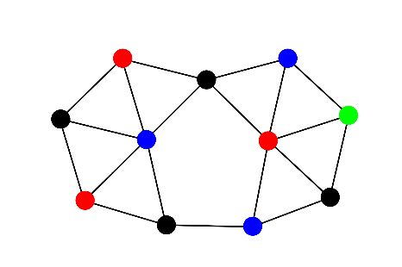
Property graph query languages
Query
input graph
output table
+------------+---------------------+
| customer | time |
+------------+---------------------+
| "Maria" | 2010-12-17T02:42:32 |
| "Iksana" | 2011-01-01T20:57:21 |
| "Franklin" | 2012-09-29T02:49:09 |
+------------+---------------------+

Slide 41
Property graph query languages
Issues with language semantics
Edges in query must all map to different edges in graph, making query evaluation intractable[1] and making certain queries hard to express.
GROUP BY and SELECT are merged into a single RETURN clause, making certain queries hard to express [2].
Limited regular expressions[3].
Etc.
[1] http://aidanhogan.com/docs/graph_database_query_survey.pdf [2] https://www.opencypher.org/blog/2017/07/27/ocig1-aggregations-blog/ [3] http://event.cwi.nl/grades/2016/07-VanRest.pdf
Query
Neo4j Proprietary
Cypher
input graph
output table
+------------+---------------------+
| customer | time |
+------------+---------------------+
| "Maria" | 2010-12-17T02:42:32 |
| "Iksana" | 2011-01-01T20:57:21 |
| "Franklin" | 2012-09-29T02:49:09 |
+------------+---------------------+

Slide 42
Property graph query languages
Syntax and semantics aligned with SQL
Well-established foundation
Familiarity for SQL users (e.g. GROUP BY, HAVING, ORDER BY)
Query
Advances in property graph querying
Full regular expressions
Pattern matching based on subgraph homomorphism
Etc.
PGQL 1.1
(Open)Cypher
input graph
output table
+------------+---------------------+
| customer | time |
+------------+---------------------+
| "Maria" | 2010-12-17T02:42:32 |
| "Iksana" | 2011-01-01T20:57:21 |
| "Franklin" | 2012-09-29T02:49:09 |
+------------+---------------------+

Slide 43
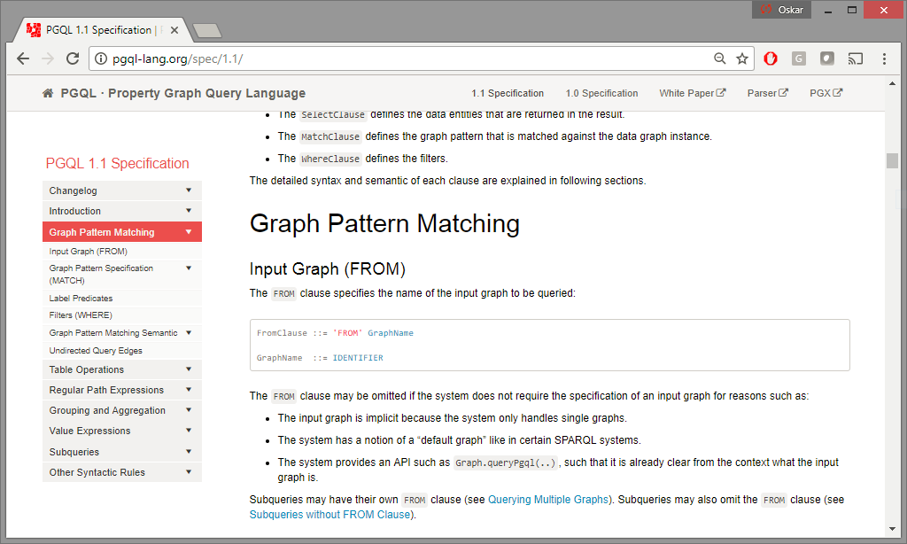
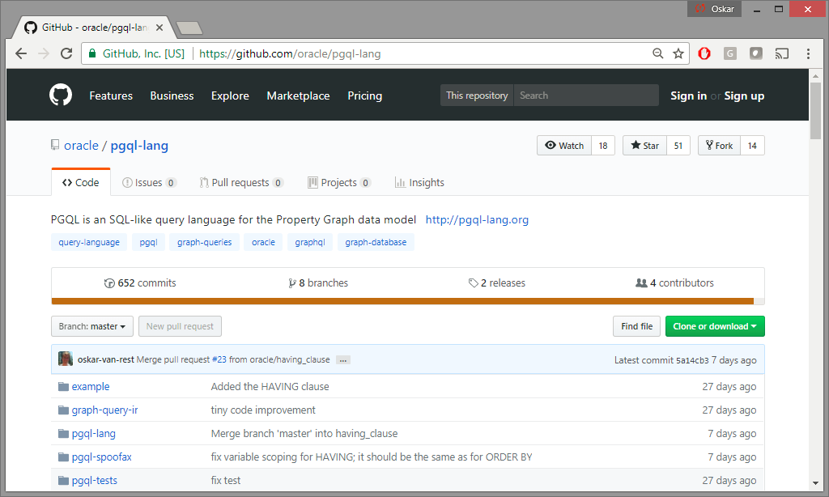
Property graph query languages
Open-sourced parser: https://github.com/oracle/pgql-lang/
Language specification: http://pgql-lang.org/spec/1.1/
Open-sourced parser
Query
Language specification
PGQL 1.1
(Open)Cypher
input graph
output table
+------------+---------------------+
| customer | time |
+------------+---------------------+
| "Maria" | 2010-12-17T02:42:32 |
| "Iksana" | 2011-01-01T20:57:21 |
| "Franklin" | 2012-09-29T02:49:09 |
+------------+---------------------+

Slide 44
Basic graph pattern matching
Find all instances of a given pattern/template in the data graph
SELECT v3.name, v3.age
FROM socialNetworkGraph
MATCH (v1:Person) –[:friendOf]-> (v2:Person) –[:knows]-> (v3:Person)
WHERE v1.name = ‘Amber’
100
:worksAt{1831}
startDate = ’09/01/2015’
:Person
name = ‘Amber’
age = 25
socialNetwork Graph
777
:Company
name = ‘Oracle’
location =
‘Redwood City’
Query: Find all people who are known by friends of ‘Amber’.
:friendOf{1173}
:friendOf {2513}
since = ’08/01/2014’
300
:Person
name = ‘Paul’
age = 30
200
:knows{2200}
:Person
name = ‘Heather’
age = 27

Slide 45
Basic graph pattern matching
Find all instances of a given pattern/template in the data graph
SELECT v3.name, v3.age
FROM socialNetworkGraph
MATCH (v1:Person) –[:friendOf]-> (v2:Person) –[:knows]-> (v3:Person)
WHERE v1.name = ‘Amber’
100
:worksAt{1831}
startDate = ’09/01/2015’
:Person
name = ‘Amber’
age = 25
socialNetwork Graph
777
:Company
name = ‘Oracle’
location =
‘Redwood City’
Query: Find all people who are known by friends of ‘Amber’.
:friendOf{1173}
:friendOf {2513}
since = ’08/01/2014’
300
:Person
name = ‘Paul’
age = 30
200
:knows{2200}
:Person
name = ‘Heather’
age = 27

Slide 46
Regular path expressions
PATH has_parent AS (child) –[:has_father|has_mother]-> (parent)
SELECT x.name, y.name, ancestor.name
FROM snGraph
MATCH (x:Person) –/:has_parent+/-> (ancestor)
, (y) -/:has_parent+/-> (ancestor)
WHERE x.name = 'Peter' AND x <> y
Matching a pattern repeatedly
Define a PATH expression at the top of a query
Instantiate the expression in the MATCH clause
Match repeatedly, e.g. zero or more times (*) or one or more times (+)
snGraph
:Person
name = ‘Amber’
age = 29
:Person
name = ‘Paul’
age = 64
100
2
:has_father
200
:likes since = ‘2016-04-04’
:has_father
3
0
1
300
:Person
name = ‘Retta’
age = 43
7
:likes since = ‘2016-04-04’
:likes since = ‘2015-11-08’
4
:has_mother
400
:has_mother
5
500
:Person
name = ‘Dwight’
age = 15
6
:likes since = ‘2013-02-14’
:Person
name = ‘Peter’
age = 12

Slide 47
Regular path expressions
PATH has_parent AS (child) –[:has_father|has_mother]-> (parent)
SELECT x.name, y.name, ancestor.name
FROM snGraph
MATCH (x:Person) –/:has_parent+/-> (ancestor)
, (y) -/:has_parent+/-> (ancestor)
WHERE x.name = 'Peter' AND x <> y
Matching a pattern repeatedly
Define a PATH expression at the top of a query
Instantiate the expression in the MATCH clause
Match repeatedly, e.g. zero or more times (*) or one or more times (+)
snGraph
:Person
name = ‘Amber’
age = 29
:Person
name = ‘Paul’
age = 64
100
2
:has_father
200
Result set
:likes since = ‘2016-04-04’
:has_father
3
+--------+--------+---------------+
| x.name | y.name | ancestor.name |
+--------+--------+---------------+
| Peter | Retta | Paul |
| Peter | Dwight | Paul |
| Peter | Dwight | Retta |
+--------+--------+---------------+
0
300
:Person
name = ‘Retta’
age = 43
1
7
:likes since = ‘2016-04-04’
:likes since = ‘2015-11-08’
4
:has_mother
400
:has_mother
5
500
:Person
name = ‘Dwight’
age = 15
6
:likes since = ‘2013-02-14’
:Person
name = ‘Peter’
age = 12

Slide 48
Example: Network Impact Analysis
Electric_Network
source device
OPEN
OPEN
How does network disruption impacts reachability between electric devices?
OPEN
OPEN
OPEN
OPEN
OPEN
OPEN
OPEN
PATH connects_to AS (from) <-[c1]- (connector) -[c2]-> (to)
WHERE c1.status = 'OPEN' AND c2.status = 'OPEN' SELECT n.nickname, COUNT(m)
FROM Electric_Network
MATCH (n:Device) -/:connects_to*/-> (m:Device)
WHERE java_regexp_like(n.nickname, 'Regulator')
AND n <> m
GROUP BY n
ORDER BY COUNT(m) DESC, n.nickname
OPEN
CLOSED
OPEN
OPEN
CLOSED
OPEN
OPEN
Query: For each ‘Regulator’ device, show number of reachable devices following only ‘OPEN’ connections.
+--------------------------+----------+
| n.nickname | COUNT(m) |
+--------------------------+----------+
| Regulator, VREG2_A | 1596 |
| Regulator, VREG4_B | 1537 |
| Regulator, VREG4_C | 1537 |
| Regulator, HVMV_Sub_RegA | 3 |
| Regulator, HVMV_Sub_RegB | 3 |
+--------------------------+----------+
OPEN
Example result
Device
OPEN
OPEN
Connector
Connection

Slide 49
Patterns, labels, regular expressions
Syntax | Description
(v1) | Match vertex v1
-[e1]-> | Match outgoing edge e1
<-[e1]- | Match incoming edge e1
-[e1]- | Match incoming or outgoing edge e1
() | Match anonymous vertex
-> <- - | Match anonymous outgoing/incoming/any-directional edge
(v1:lbl1|lbl2) | Match vertex v1 with label lbl1 or lbl2
-[:lbl1]-> | Match anonymous outgoing edge with label lbl1
Syntax | Description
-/:lbl/-> | Matches if there exists a path that connects the source and destination by one match of the given pattern
-/:lbl*/-> | Matches if there exists a path that connects the source and destination by zero or more matches of the given pattern
-/:lbl+/-> | Matches if there exists a path that connects the source and destination by one or more matches of the given pattern
-/:lbl?/-> | Matches if there exists a path that connects the source and destination by zero or one matches of the given pattern
-/:lbl{2}/-> | Matches if there exists a path that connects the source and destination by exactly 2 matches of the given pattern
-/:lbl{2,}/-> | Matches if there exists a path that connects the source and destination by at least 2 matches of the given pattern
-/:lbl{2,3}/-> | Matches if there exists a path that connects the source and destination by at least 2 and at most 3 (inclusive) matches of the given pattern
-/:lbl{,3}/-> | Matches if there exists a path that connects the source and destination by at least 0 and at most 3 (inclusive) matches of the given pattern

Slide 50
Cartesian product
Disconnected graph patterns result in Cartesian product
SELECT c1.first_name, c2.first_name
FROM "Movies Graph"
MATCH (c1), (c2) –[:click]-> (m)
WHERE c1.first_name = 'Maria' , m.title = 'Match Point'
Movies Graph
type : ‘customer’
first_name : ‘Iksana’
+---------------+
| c2.first_name |
+---------------+
| Maria |
| Iksana |
| Franklin |
+---------------+
type : ‘movie’
title : ‘Match Point’
+---------------+ | c1.first_name |
+---------------+
| Maria |
+---------------+
400
x
time : 2010-12-17T02:42:32
100
200
click 2
click 0
type : ‘customer’
first_name : ‘Maria’
time : 2011-01-01T20:57:21
+---------------+---------------+
| c1.first_name | c2.first_name |
+---------------+---------------+
| Maria | Maria |
| Maria | Iksana |
| Maria | Franklin |
+---------------+---------------+
click 1
click 3
time : 2012-09-29T02:49:09
=
time : 2011-08-25T20:19:40
500
300
type : ‘movie’
title : ‘Yes Man’
type : ‘customer’
first_name : ‘Franklin’

Slide 51
SELECT and WHERE clause
WHERE (optional) contains a filter expression:
The filter expression typically involves properties of vertices/edges defined in the MATCH clause
e.g. WHERE m.budget > 1000000 AND m.budget < 2000000 AND …
SELECT creates tabular projection of results
Specify alias names through SELECT exp AS var
e.g. SELECT (m.budget / 1000000.0) AS budget_in_millions, …
SELECT DISTINCT makes a set out of a multiset (i.e. removes duplicates)
The expression system is similar to the one in SQL:
Operator type | Operator | Example PGQL
Arithmetic | +, -, *, /, % | 1 + 1
Relational | =, <>, <, >, <=, >= | 3 < 4
Logical | AND, OR, NOT | true AND NOT false

Slide 52
Data types in PGQL on PGX (note: in PGQL-to-SQL, the available data types correspond to those in Oracle RDBMS)
Data type | Name in PGX config | Example PGQL literal | Implicitly converts to (e.g. integer + long => LONG)
STRING | string | 'Franklin'
INTEGER | integer | - | LONG, FLOAT, DOUBLE
LONG | long | 2000 | FLOAT, DOUBLE
FLOAT | float | - | DOUBLE
DOUBLE | double | 1.95
BOOLEAN | boolean | true
DATE | local_date (note: don’t use deprecated date) | DATE '2017-08-18'
TIME | time | TIME '20:15:00' | TIME WITH TIME ZONE
TIMESTAMP | timestamp | TIMESTAMP '2017-08-18 20:15:00' | TIMESTAMP WITH TIME ZONE
TIME WITH TIME ZONE | time_with_timezone | TIME '20:15:00+08' | TIME
TIMESTAMP WITH TIME ZONE | timestamp_with_timezone | TIMESTAMP '2017-08-18 20:15:00+08' | TIMESTAMP

Slide 53

Built-in functions
Function | Description | Return type
id(vertex/edge) | get the identifier of a vertex or edge | exact numeric / string
has_label(vertex/edge, lbl) | returns true if the vertex/edge has the label; false otherwise | boolean
labels(vertex) | returns the labels of a vertex | set<string>
label(edge) | returns the label of an edge | string
all_different(value1, value2, value3, …) | returns true if the values are all different, e.g. all_different(1, 5, 2) ➔ true e.g. all_different(1, 5, 1) ➔ false | boolean
in_degree(vertex) | get outgoing number of edges | exact numeric
out_degree(vertex) | get incoming number of edges | exact numeric
java_regexp_like(string, pattern) | returns whether the string matches the pattern¹ | boolean
Use all_different to avoid explosion of non-equality constraints:
SELECT COUNT(*) MATCH (p1:Person) -[:likes]-> (friend:Person) , (p2:Person) -[:likes]-> (friend) , (p3:Person) -[:likes]-> (friend) WHERE p1 <> p2 AND p1 <> p3 AND p2 <> p3
SELECT COUNT(*) MATCH (p1:Person) -[:likes]-> (friend:Person) , (p2:Person) -[:likes]-> (friend) , (p3:Person) -[:likes]-> (friend) WHERE all_different(p1, p2, p3)
¹ see https://docs.oracle.com/javase/7/docs/api/java/util/regex/Pattern.html

Slide 54
CAST
Convert from string:
CAST('true' AS BOOLEAN) => true
CAST('2.50' AS DOUBLE) => 2.50
CAST('2017-08-18' AS DATE) => DATE '2017-08-18‘
Convert to string:
CAST(true AS STRING) => 'true'
CAST(2.50 AS STRING) => '2.50'
CAST(DATE '2017-08-18' AS STRING) => '2017-08-18'
Narrowing numeric conversion
CAST(1.2 AS INTEGER) => 1
Extract date or time portion from a timestamp:
CAST(TIMESTAMP '2017-08-18 20:15:00' AS DATE) => DATE '2017-08-18'
CAST(TIMESTAMP '2017-08-18 20:15:00' AS TIME) => TIME '20:15:00'
Create a timestamp from a date or a time:
CAST(DATE '2017-08-18' AS TIMESTAMP) => TIMESTAMP '2017-08-18 00:00:00'
CAST(TIME '20:15:00' AS TIMESTAMP) => TIMESTAMP '2018-03-19 20:15:00'
It takes the current date to create a timestamp

Slide 55
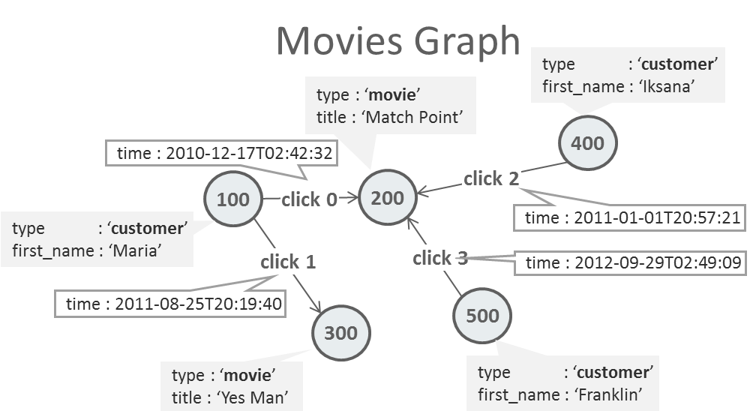
Grouping and aggregation
GROUP BY creates groups of intermediate solutions
COUNT, MIN, MAX, SUM, AVG to compute aggregations over groups of solutions
Use DISTINCT to eliminate duplicates before aggregation
E.g. COUNT(DISTINCT n.name)
Omit GROUP BY to aggregate over the entire set of solutions (returns a single row)
HAVING filters entire groups of solutions
E.g. HAVING COUNT(*) > 10
Query: “for each movie, return the time of the most recent click”
SELECT m.title, MAX(e.time)
FROM "Movies Graph"
MATCH (m) <-[e:click]- ()
WHERE m.type = 'movie'
GROUP BY m
+---------------+---------------------+
| m.title | MAX(e.time) |
+ --------------+---------------------+
| "Yes Man" | 2011-08-25T20:19:40 |
| "Match Point" | 2010-12-17T02:42:32 |
+---------------+---------------------+

Slide 56
ORDER BY, LIMIT, OFFSET
ORDER BY
Sort result ascendingly (default): ORDER BY n.prop ASC, …
Sort result descendingly: ORDER BY n.prop DESC, …
LIMIT and OFFSET
For returning the “top-k” results or for “pagination” of results
E.g. OFFSET 200 LIMIT 100 returns results 200 to 300
Movies Graph
type : ‘customer’
first_name : ‘Iksana’
type : ‘movie’
title : ‘Match Point’
Query: “order customers by first name and return first two results”
SELECT n.first_name
MATCH (n)
WHERE n.type = 'customer'
ORDER BY n.first_name
LIMIT 2
400
time : 2010-12-17T02:42:32
100
200
click 2
click 0
type : ‘customer’
first_name : ‘Maria’
time : 2011-01-01T20:57:21
click 1
click 3
time : 2012-09-29T02:49:09
+--------------+
| n.first_name |
+--------------+
| Franklin |
| Iksana |
+--------------+
time : 2011-08-25T20:19:40
500
300
type : ‘movie’
title : ‘Yes Man’
type : ‘customer’
first_name : ‘Franklin’

Slide 57
EXISTS subqueries
EXISTS tests for the existence of a pattern, given the already obtained bindings
Query: “Find friends of friends of Peter”
SELECT DISTINCT friendOfFriend.name
MATCH (a:Person) –[:friend_of]-> () –[:friend_of]-> (friendOfFriend)
WHERE a.name = 'Peter'
AND NOT EXISTS ( SELECT *
MATCH (a) –[:friend_of]-> (friendOfFriend)
)
Instead of using SELECT DISTINCT it’s sometimes faster to test for path existence using -/../-> :
SELECT friendOfFriend.name
MATCH (a:Person) –/:friend_of{2}/-> (friendOfFriend)
WHERE a.name = 'Peter'
More concise way of expressing the query

Slide 58
EXISTS subquery in PATH expression
Query: “In a code base, find functions that are reachable from 'func1' such that no function along the “calls path” transitively writes to a global variable”
PATH calls_but_no_global_write AS (:Function) –[:calls]-> (dst:Function)
WHERE NOT EXISTS (
SELECT *
MATCH (dst) -/:calls*/-> (:Function) –[:writes]-> (:GlobalVariable) )
SELECT f2.name
MATCH (f1:Function) -/:calls_but_no_global_write+/-> (f2)
WHERE f1.name = 'func1'

Slide 59
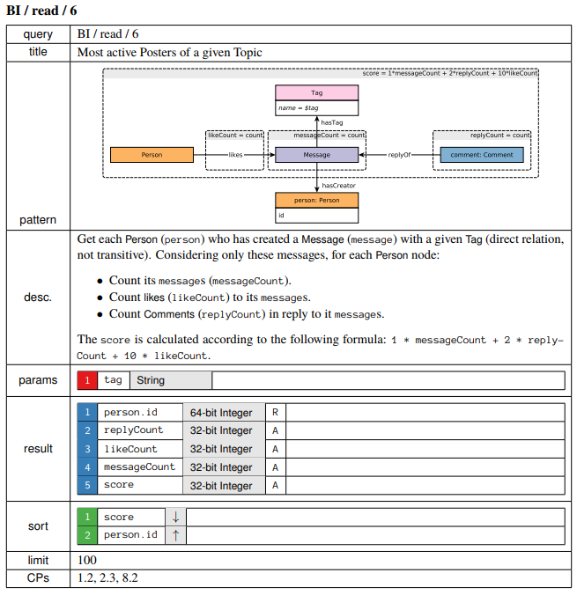
Scalar subqueries (product support upcoming)
LDBC Benchmark query
SELECT person.id
, SUM((SELECT COUNT(r)
MATCH (message)<-[r:replyOf]-(comment:comment))
) AS replyCount
, SUM((SELECT COUNT(l)
MATCH (:person)-[l:likes]->(message))
) AS likeCount
, COUNT(*) AS messageCount
MATCH (tag:tag) <-[:hasTag]- (message:post|comment)
, (message) -[:hasCreator]-> (person:person)
WHERE tag.name = ?
GROUP BY person, tag
ORDER BY 1*messageCount + 2*replyCount + 10*likeCount DESC , person.id
LIMIT 100

Slide 60
Property graph query languages
Syntax and semantics aligned with SQL
Well-established foundation
Familiarity for SQL users (e.g. GROUP BY, HAVING, ORDER BY)
Query
Advances in property graph querying
Full regular expressions
Pattern matching based on subgraph homomorphism
Etc.
PGQL 1.1
(Open)Cypher
input graph
output table
+------------+---------------------+
| customer | time |
+------------+---------------------+
| "Maria" | 2010-12-17T02:42:32 |
| "Iksana" | 2011-01-01T20:57:21 |
| "Franklin" | 2012-09-29T02:49:09 |
+------------+---------------------+

Slide 61
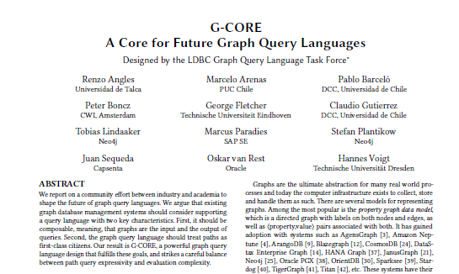
Property graph query languages
LDBC’s G-CORE
Result of 2.5 years of discussions with academia (various universities) and industry (Capsenta, HP, Huawei, IBM, Neo4j, Oracle, SAP and Sparsity)
Meant to guide the evolution of both existing and future graph query languages (e.g. SQL/PG, PGQL, Cypher)
Not (yet) implemented by anyone
output graph
LDBC’s G-CORE
Query
LDBC’s G-CORE
Ability to return graphs from queries allows for:
Subqueries
Views
PGQL 1.1
(Open)Cypher
input graph
output table
+------------+---------------------+
| customer | time |
+------------+---------------------+
| "Maria" | 2010-12-17T02:42:32 |
| "Iksana" | 2011-01-01T20:57:21 |
| "Franklin" | 2012-09-29T02:49:09 |
+------------+---------------------+

Slide 62
Property graph query languages
output graph
LDBC’s G-CORE
Query
PGX can already create certain built-in views:
Subgraphs through vertex/edge filters
“PageRanked” graph
Etc.
General view capability will allow for additional kinds of applications
Querying views through PGQL (supported today)
E.g. Find 10 vertices with the highest PageRank value: SELECT n.pr_value FROM PageRankedGraph MATCH (n) ORDER BY n.pr_value DESC LIMIT 10
LDBC’s G-CORE
PGQL 1.1
(Open)Cypher
input graph
output table
+------------+---------------------+
| customer | time |
+------------+---------------------+
| "Maria" | 2010-12-17T02:42:32 |
| "Iksana" | 2011-01-01T20:57:21 |
| "Franklin" | 2012-09-29T02:49:09 |
+------------+---------------------+
PGQL +
Built-in PGX algorithms +
PGX Subgraph Creation

Slide 63

Property graph query languages
SQL/PG v1
+------------+---------------------+
| customer | time |
+------------+---------------------+
| "Maria" | 2010-12-17T02:42:32 |
| "Iksana" | 2011-01-01T20:57:21 |
| "Franklin" | 2012-09-29T02:49:09 |
+------------+---------------------+
input table
output graph
LDBC’s G-CORE
Query
SQL/PG
Property Graph extension for SQL 2020
Multiple teams at Oracle involved
Multiple vendors involved: Oracle, Neo4j, Microsoft, SAP, IBM, etc.
LDBC’s G-CORE
PGQL 1.1
(Open)Cypher
We’re trying to improve PGQL through SQL/PG and vice versa
input graph
SQL/PG
output table
PGQL
+------------+---------------------+
| customer | time |
+------------+---------------------+
| "Maria" | 2010-12-17T02:42:32 |
| "Iksana" | 2011-01-01T20:57:21 |
| "Franklin" | 2012-09-29T02:49:09 |
+------------+---------------------+
PGQL + Built-in PGX algorithms

Slide 64
Property graph query languages
SQL/PG v1
+------------+---------------------+
| customer | time |
+------------+---------------------+
| "Maria" | 2010-12-17T02:42:32 |
| "Iksana" | 2011-01-01T20:57:21 |
| "Franklin" | 2012-09-29T02:49:09 |
+------------+---------------------+
input table
output graph
LDBC’s G-CORE
Query
LDBC’s G-CORE
long-term direction for property graph query languages?
PGQL 1.1
(Open)Cypher
input graph
output table
+------------+---------------------+
| customer | time |
+------------+---------------------+
| "Maria" | 2010-12-17T02:42:32 |
| "Iksana" | 2011-01-01T20:57:21 |
| "Franklin" | 2012-09-29T02:49:09 |
+------------+---------------------+
PGQL + Built-in PGX algorithms

Slide 65
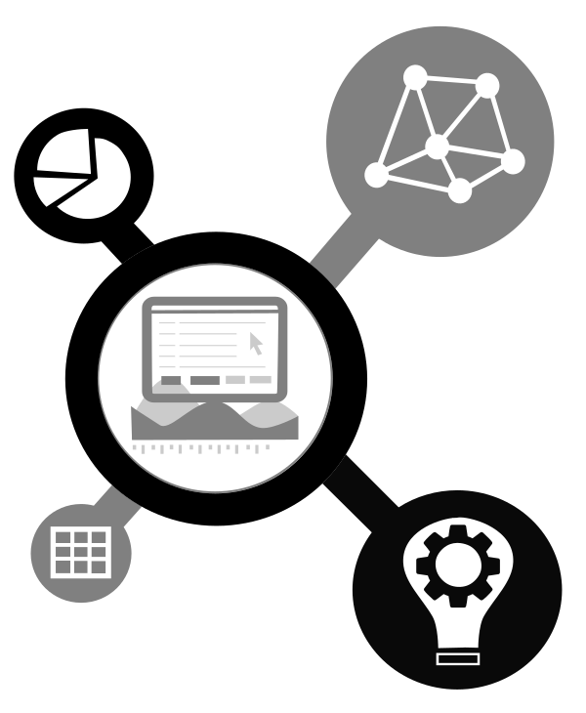
Oracle Labs Data Studio
Data Science with Interactive and Collaborative Notebooks

Slide 66
Architecture Overview
Integrated with various Oracle and open source data storage technologies
Interoperates with open-source frameworks, e.g. Apache Spark
In-memory engines for single-machine or distributed execution
Multiple language bindings for remote execution via REST
Notebooks and visualization
(Remote) Clients (Java, Groovy,
R, JS, …)
Visualization
PGX
Rest API
Shared Memory
Distributed
File System
…
Notes:
End-to-end solution to users via multiple layers of integrations

Slide 67



Data Science: What tools are typically required?
Data Science process
Frontend tools
Exploratory
Data
Analysis
Quick, interactive execution
Visualization of results
Support for modern programming languages
Remote execution to Cloud
Notebook
IDE for
Data Science
Raw Data
Collected
Data is
Processed
Clean Dataset
Models &
Algorithms
Backend tools
Scalable data manipulation
Efficient computational engines
Built-in algorithms and methodologies
Customization via end-user software engineering
Data
Product
Communicate Visualize Report
Make Decisions
"Doing Data Science", Cathy O'Neil and Rachel Schutt, 2013

Slide 68



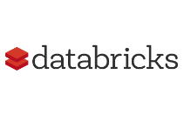

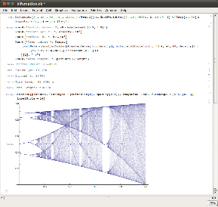
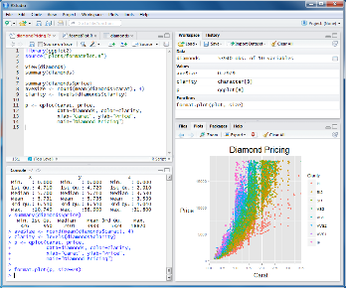
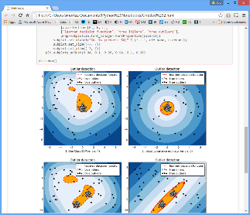
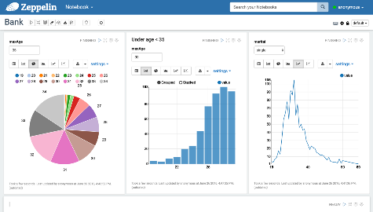
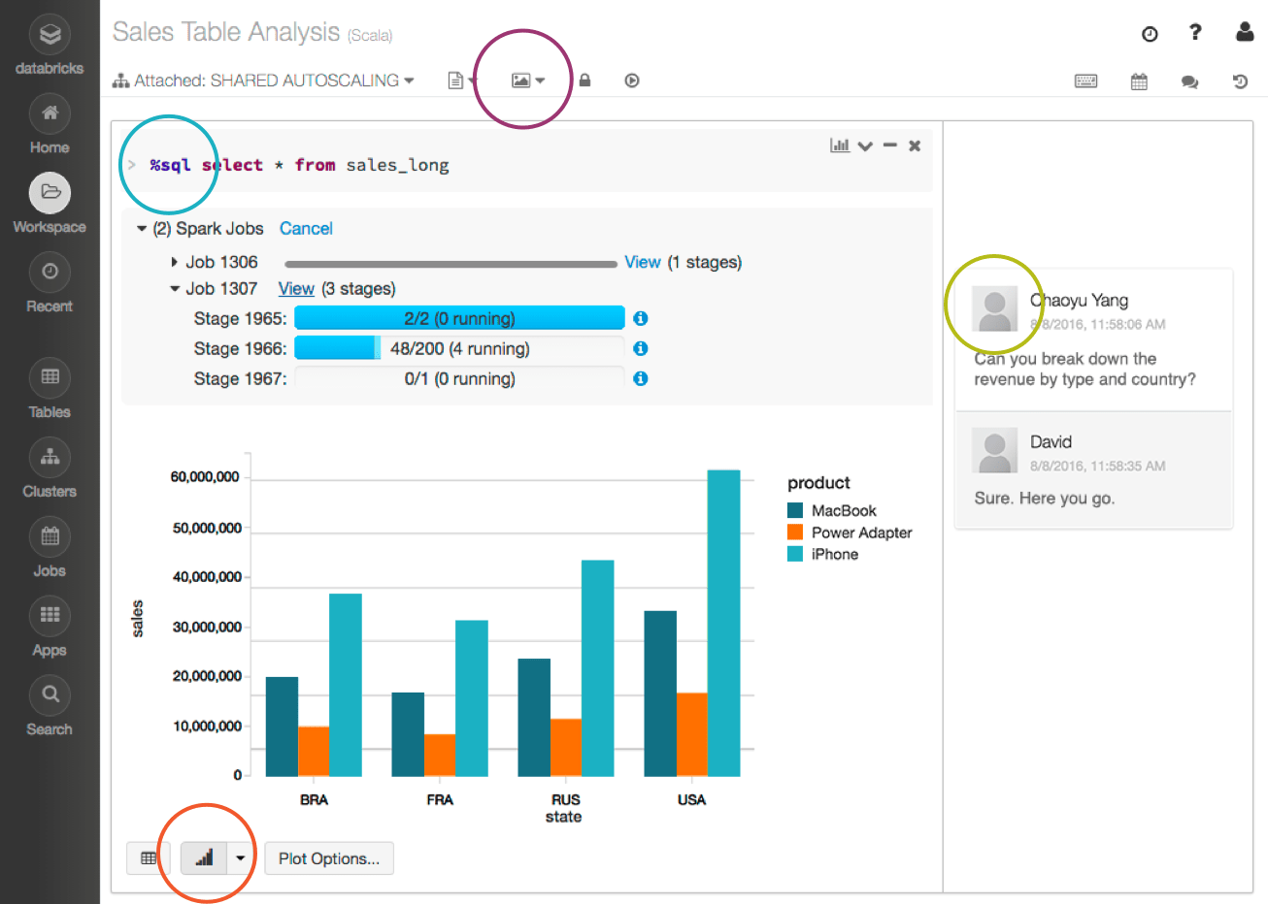
Rise of Notebook Technology
Early tools
Recent trends
Single, dedicated programming language
Stand-alone desktop applications
Local execution
REPL-style execution, embedded visualization
Multiple languages, general-purpose languages
Browser-based
Execution in Cloud, enables collaborative editing
Notes:
Notebook tools have been a long time around us
Early tools still evolving

Slide 69
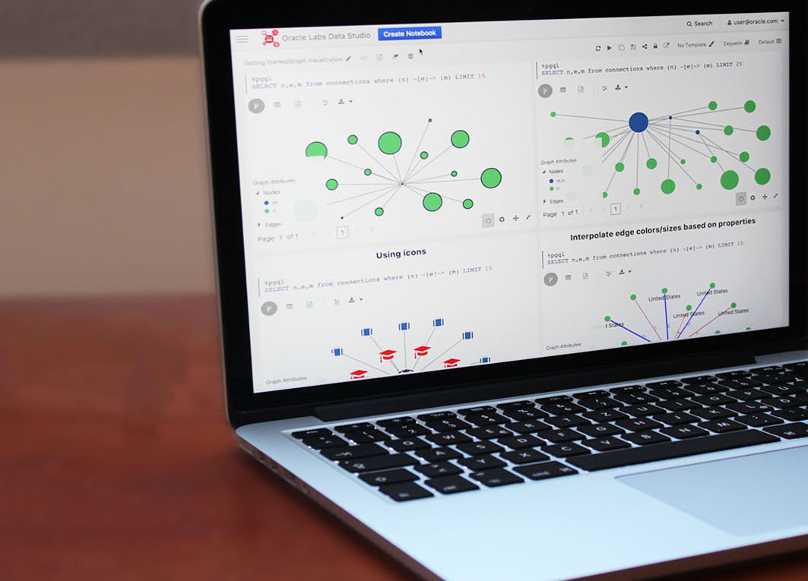
Oracle Labs Data Studio
Notebook technology from Oracle Labs
Built using Oracle JET
Extensible
Focus on Enterprise
Integration with Oracle Technologies:
Graph Analysis
Graph Visualization
Advanced polyglot support (Graal)
In-database execution (Walnut)

Slide 70
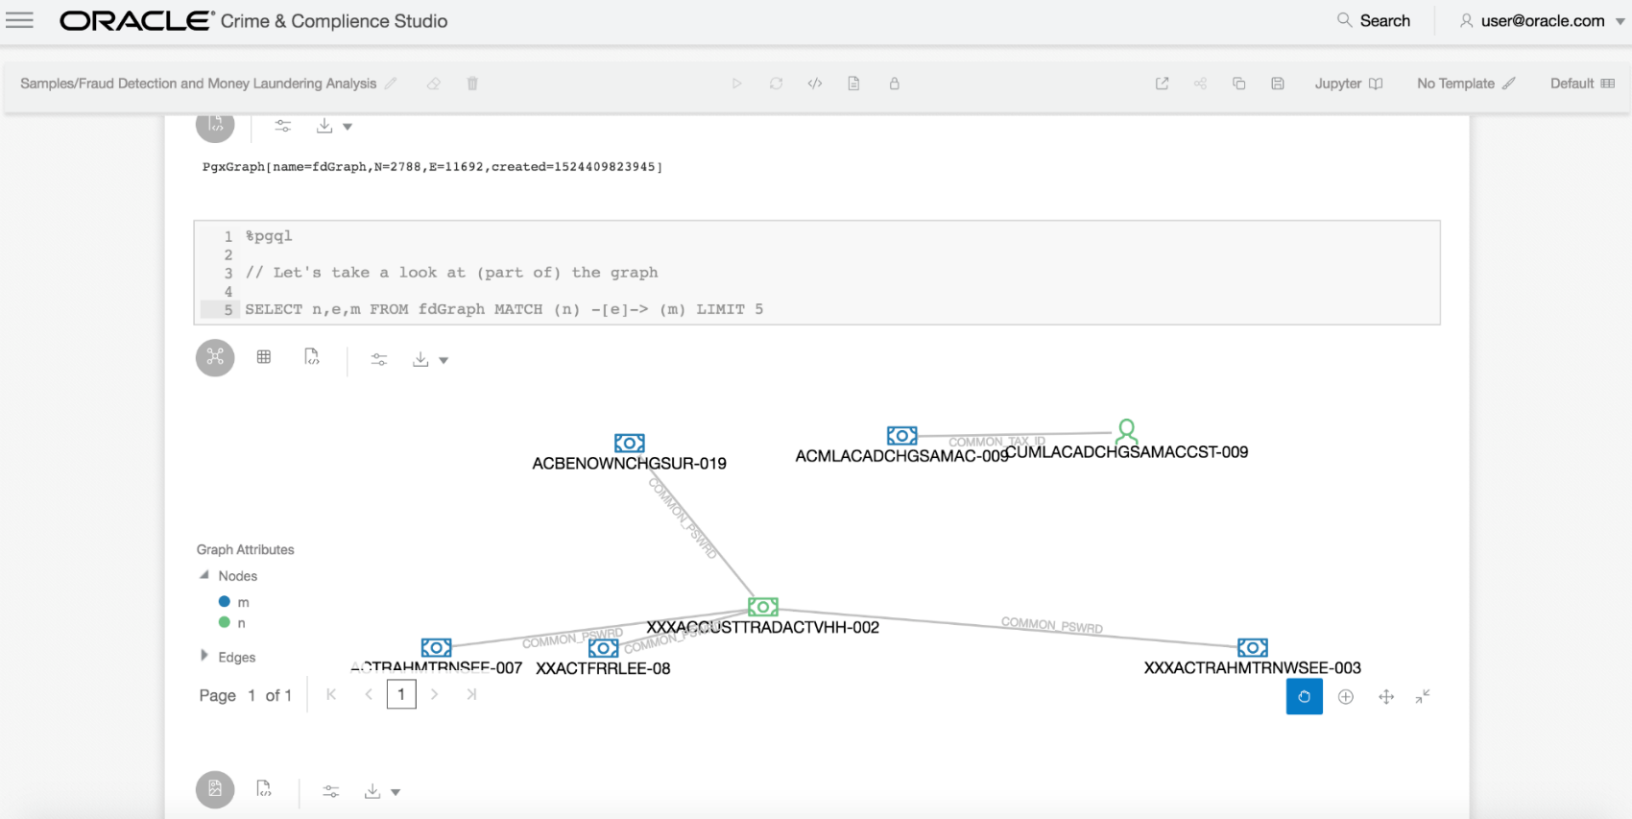

Financial Services Crime and Compliance Studio
Large deals already signed in Q4 ranged 200K to 1M per deal
Graph analytics for money laundering prevention and fraud detection

Slide 71
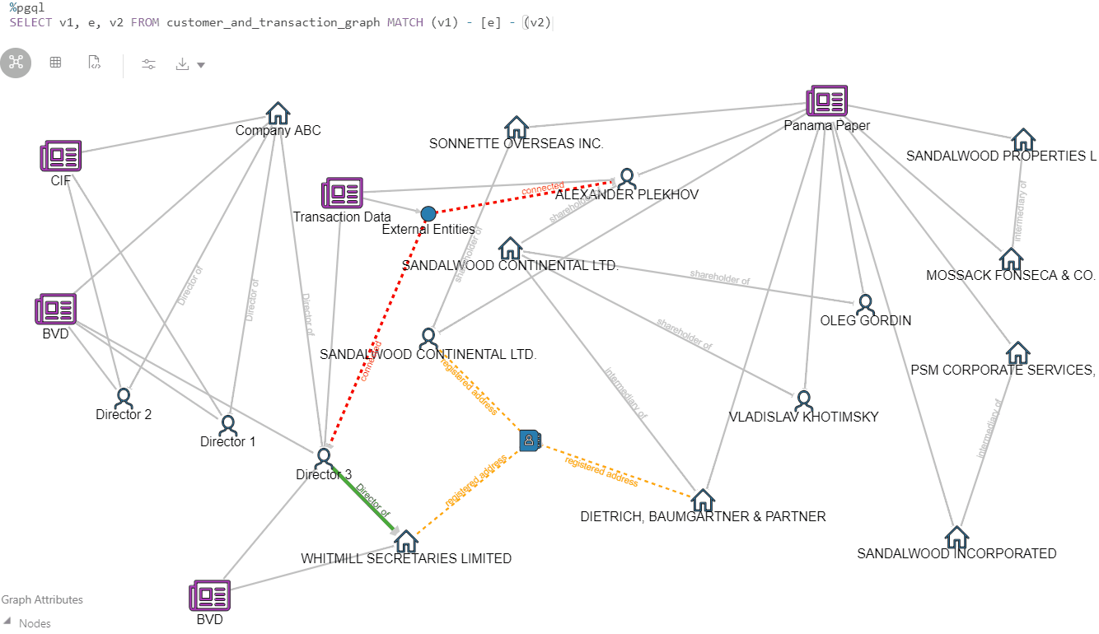
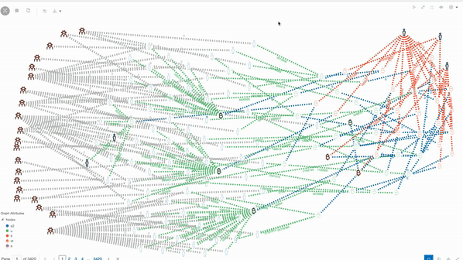
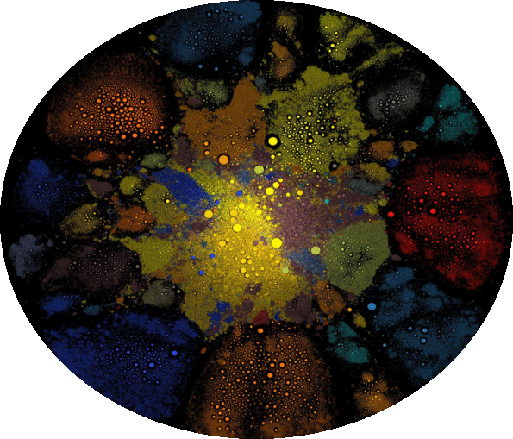
Roadmap and Futures for Data Studio
Scale the concept from coders (notebooks) to business user analysts (pipelines) to lightweight data oriented apps
Graph Exploration
Pipelines/Widgets
Interpreter-Clients (Jupyter, internal)
Extension System
Job Scheduling
Oracle Graph Training

Slide 72
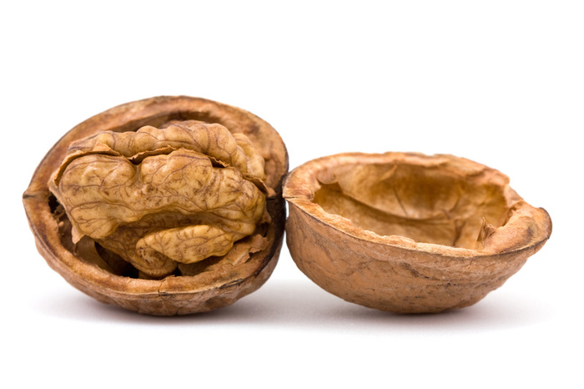
Walnut
Multi-Lingual Data Processing with GraalVM

Slide 73
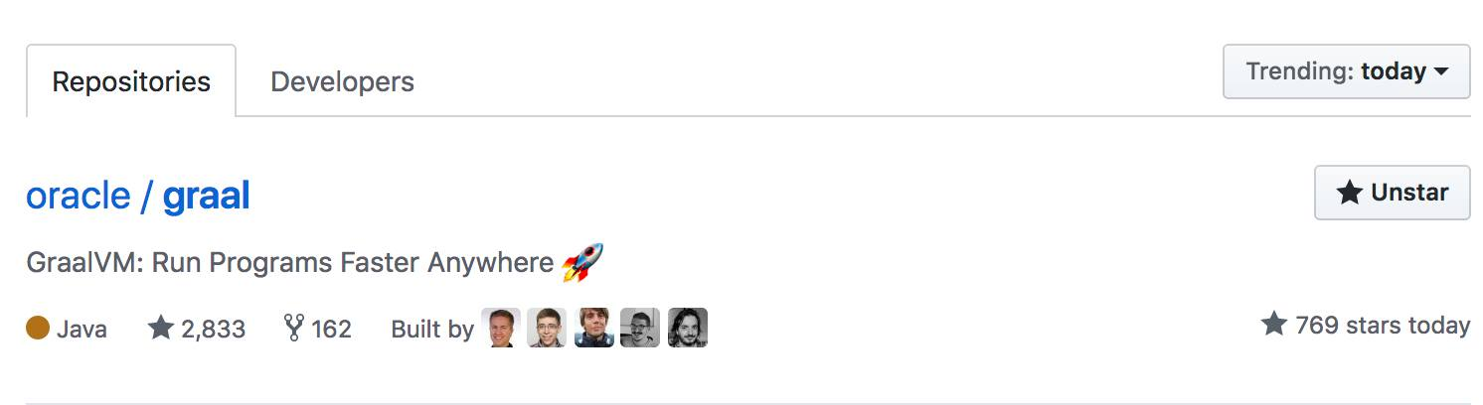
GraalVM: Oracle Labs Technology on GitHub
Notes:
Oracle does a lot of commercial software, but also open source
one project that you might have noticed in recent months on Github, reddit or Hacker News is GraalVM
open source. developed by Oracle Labs
Project Walnut uses GraalVM to extend data processing engines

Slide 74
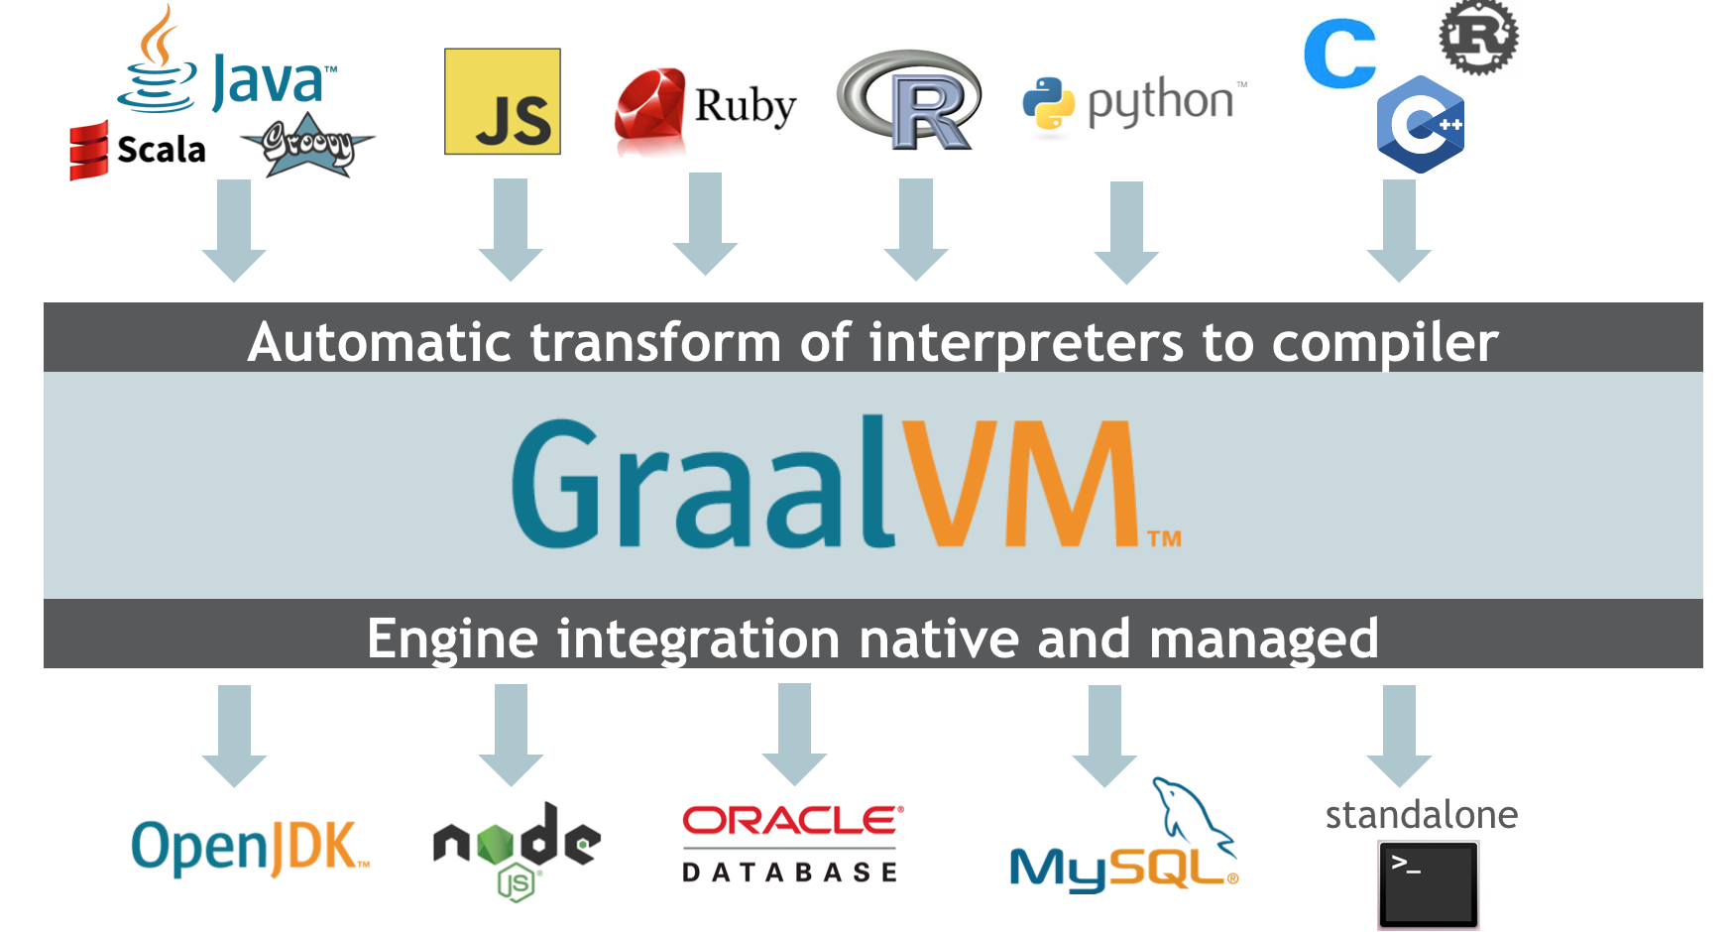
GraalVM: Multi-Lingual, Embeddable Virtual Machine
Multi-Lingual
Embeddable
Notes:
what is GraalVM?
Virtual Machine like Java Virtual Machine or Google V8
Multilingual: can run a variety of programming languages - JVM languages + many others
high-performance execution: Just In Time compilation for all languages
Embeddable: can be used stand-alone or embedded in engines

Slide 75
GraalVM: Multi-Lingual, Embeddable Virtual Machine
Multi-Lingual
Embeddable
Notes:
let's focus on one particular engine: Oracle Database
That's the focus of Project Walnut

Slide 76

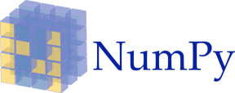

Walnut: Multi-Lingual Data Processing with GraalVM
Multi-Lingual Database
In-Database Data Science
Integrate new programming languages into RDBMS
Data processing logic in modern languages: JavaScript, Python, Java, …
Rapid, efficient, eco-system friendly
Familiar ecosystems for Data Science, Machine Learning
Python: Pandas, scikit-learn, …
Execute efficiently in database
“compute close to the data”
Interoperability between data models (graph, relational, linear algebra)
function helloJS(name) {
return ‘Hello ‘ + name;
}
SELECT helloJS(ENAME) FROM EMP;
Notes:
Databases have SQL and PL/SQL for user-defined logic
developers want to use modern languages like JavaScript, Python
integrating new languages in RDBMS is a lot of work
Embed multi-lingual GraalVM to have this effort only once
Example: use a JavaScript function inside a SQL query
we have been working on integrating programming languages for quite a while
still many interesting challenges
New and increasingly important focus: data science in the database
Data science (exploration of data, modelling, learning) is everywhere
Lots of data is stored in relational databases (e.g. Oracle Database)
Users want to use libraries/environments that they are used to
Nowadays, that often means Python and the stack of numpy, pandas, scikit-learn
But: don't want to pull out raw data from database (efficiency, security)
Walnut: provide familiar data science environment *inside* the database
analysis code is efficiently executed by the database, close to the data
interesting and challenging intern projects in all those areas

Slide 77
Oracle Labs Zurich

Slide 78
Internships at Oracle Labs Zurich
3-12 months internships
Regular internships or MSc thesis topics
Openings at TU Delft Career Centre
CHF 3700 gross salary

Slide 79
The Intern Life in Zurich

